Slide 1
HOSPITALITY MANAGEMENT
Presented by Group-6
Team Members :- AMAN, Sukanya, KETKI, VENU, MANI, REHAN,ANKIT

Slide 2
Data-Driven Transformation for Shodwe Group
Enhancing Hospitality Performance with BI Dashboards
Date: 02AUG2025

Slide 3
About Shodwe Group
- One of India's largest hospitality chains
- Operates properties across multiple states
- Handles thousands of bookings monthly

Slide 4
Key Pain Points Identified
- Manual Excel-based reports – slow, inconsistent
- No real-time visibility into revenue and occupancy
- Inability to compare state-wise and property-wise performance
- No tracking of weekday vs weekend trends
- No insight into room category performance or cancellation patterns
- Reactive decision-making by management

Slide 5
Project Goals
- Automate KPI reporting with interactive dashboards
- Provide real-time insights into key hospitality metrics
- Enable comparison across states and properties
- Track booking behavior across weekdays/weekends
- Support proactive revenue and capacity decisions

Slide 6
Tools Used
Project Management Tools
Excel
PowerBI
Tableau
My Sql

Slide 7
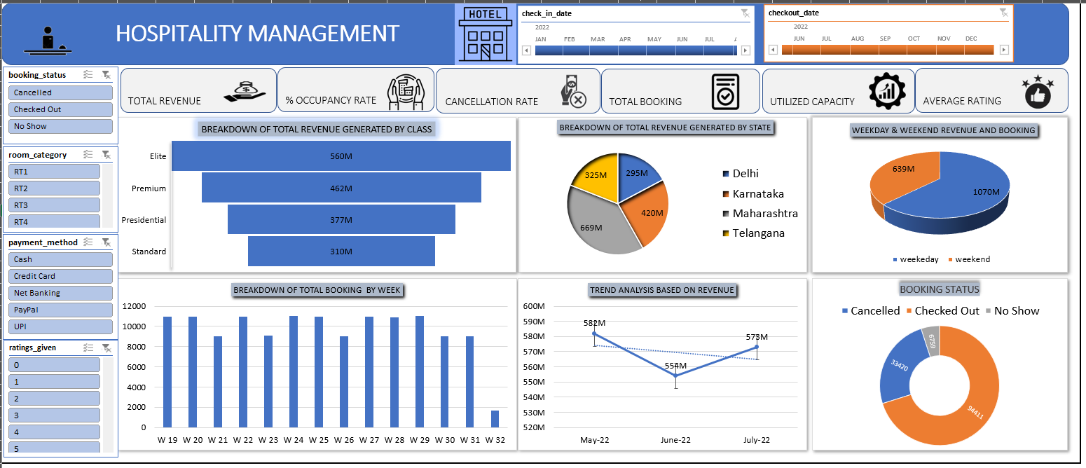

Slide 8
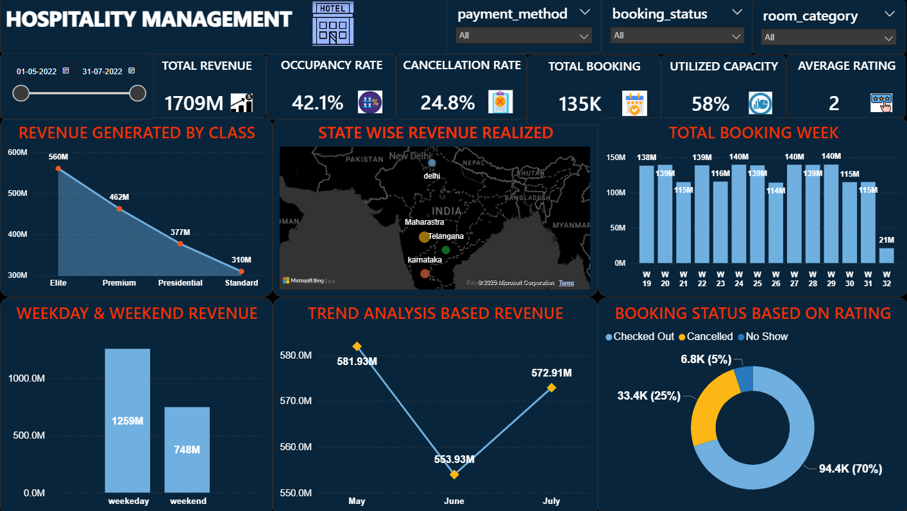
Tools Used

Slide 9
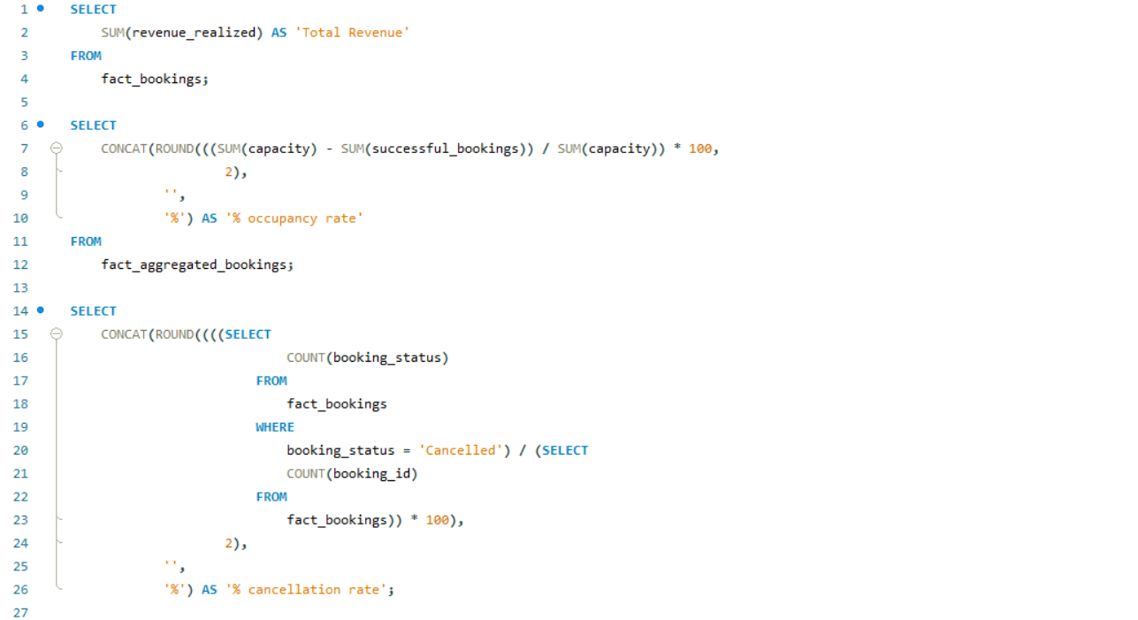

Slide 10
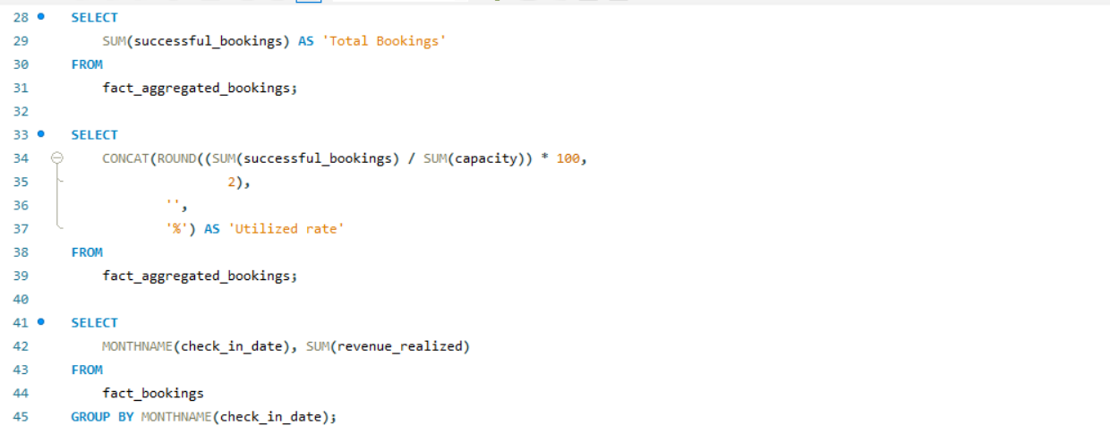

Slide 11
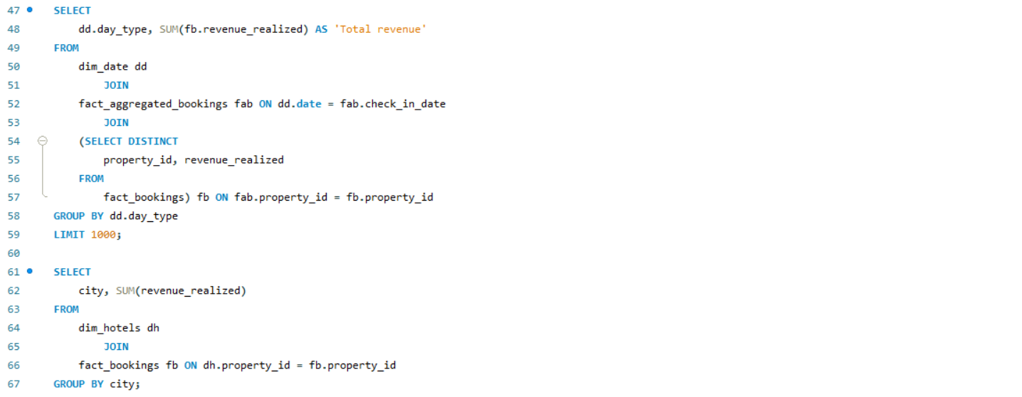

Slide 12
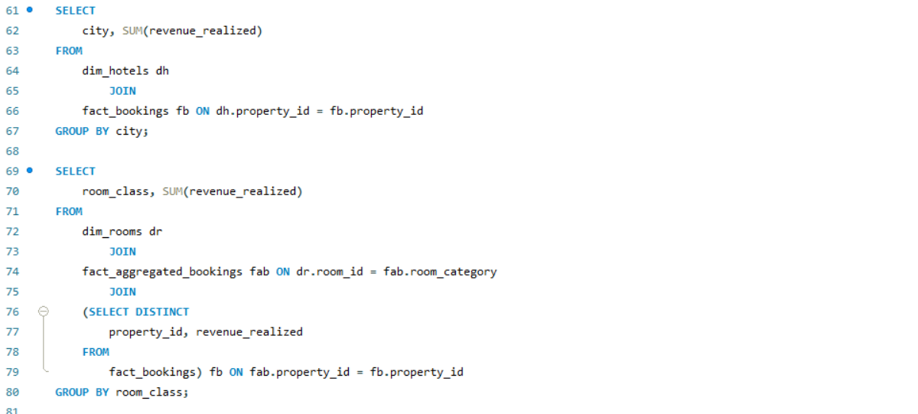

Slide 13
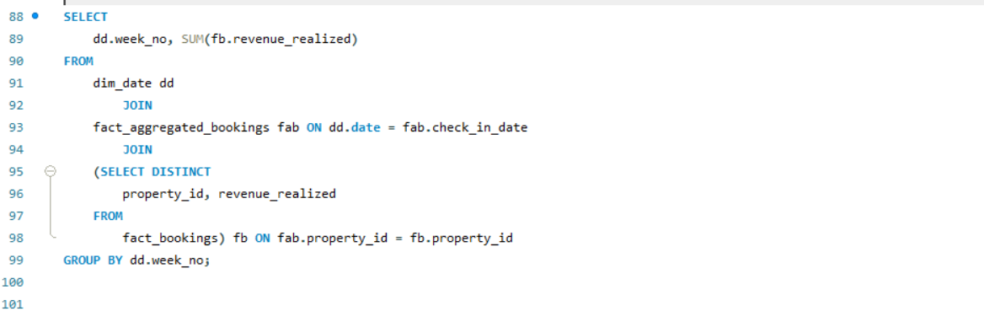

Slide 14
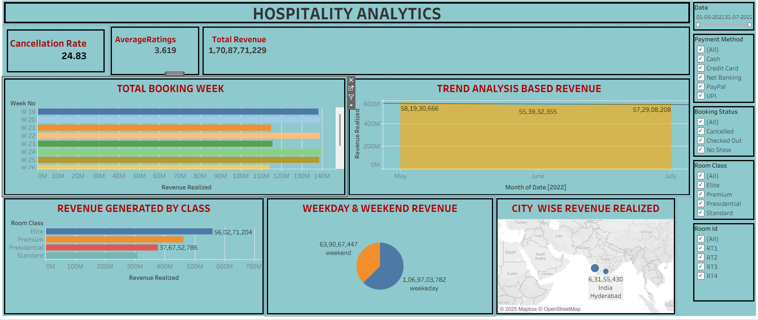

Slide 15
Key Metrics Monitored
• Total Revenue – Total income from successful bookings:- 1709M
• Occupancy Rate – % of booked rooms out of total available :- 42.1%
• Cancellation Rate – % of bookings canceled before check-in:- 24.8%
• Total Bookings – All bookings regardless of status:- 135k
• Utilized Capacity – Actual usage of available capacity:- 58%
• Weekday vs Weekend – Booking and revenue by day type
• Revenue by State & Hotel – Performance comparison
• Room Category Revenue – Revenue split by room class
• Checked Out / Cancel / No Show – Behavior breakdown
• Weekly Trends – Time-based performance insights

Slide 16
Outcomes Achieved
- 80% reduction in report preparation time
- Instant visibility into occupancy and revenue by location
- Better demand forecasting and price optimization
- Early identification of cancellation patterns
- Proactive decision-making using trend analysis

Slide 17
Thank You!

